Slide 1








MEDENGINEERS
ميد إنجينيرز
2026
WeqayahToken
Incentivized Preventative Care
Muhammad Abir, Muhammed Rehan, Rushada Zoya, Salman Alshehhi, Shrreya jain
Code Yellow
(14)

Slide 2

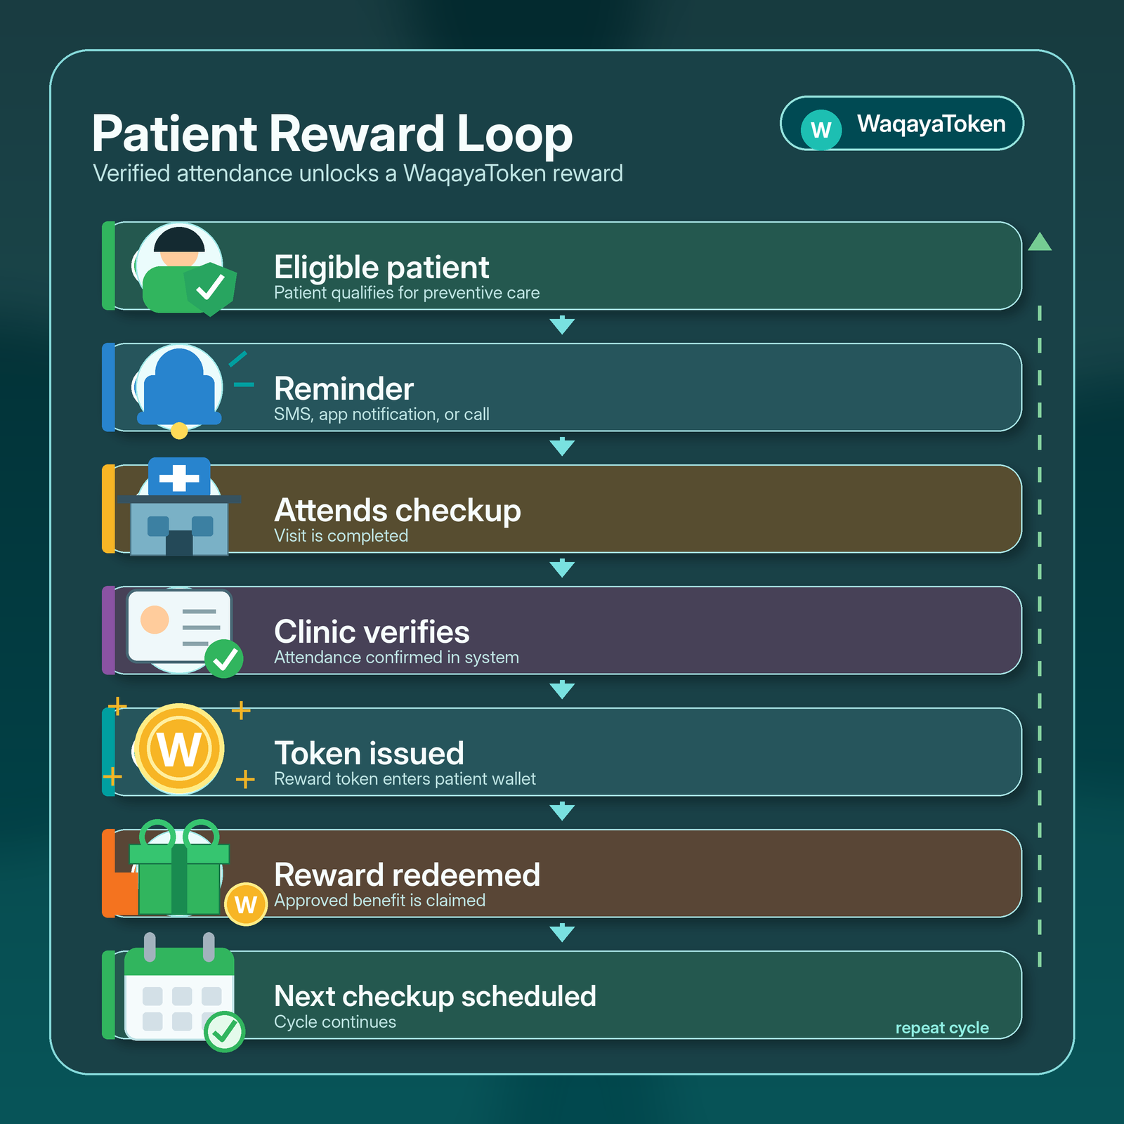
PROJECT VISION
Ai generated image
WeqayahToken motivates patients to complete recommended preventive checkups, screenings, and follow-up appointments by issuing verified health tokens after attendance is confirmed.
verified
Verified rewards for completed care
Not just reminders, but tangible incentives for attendance.
monetization_on
Earn tokens after attendance
Issued after eligible checkups, screenings, or follow-up visits.
redeem
Redeemable benefits
Wellness vouchers, transport/parking, pharmacy products, or insurance credits.
location_on
Pilot Focus: UAE Primary Care
Focusing on outpatient patients due for preventive screening or follow-up.

Slide 3

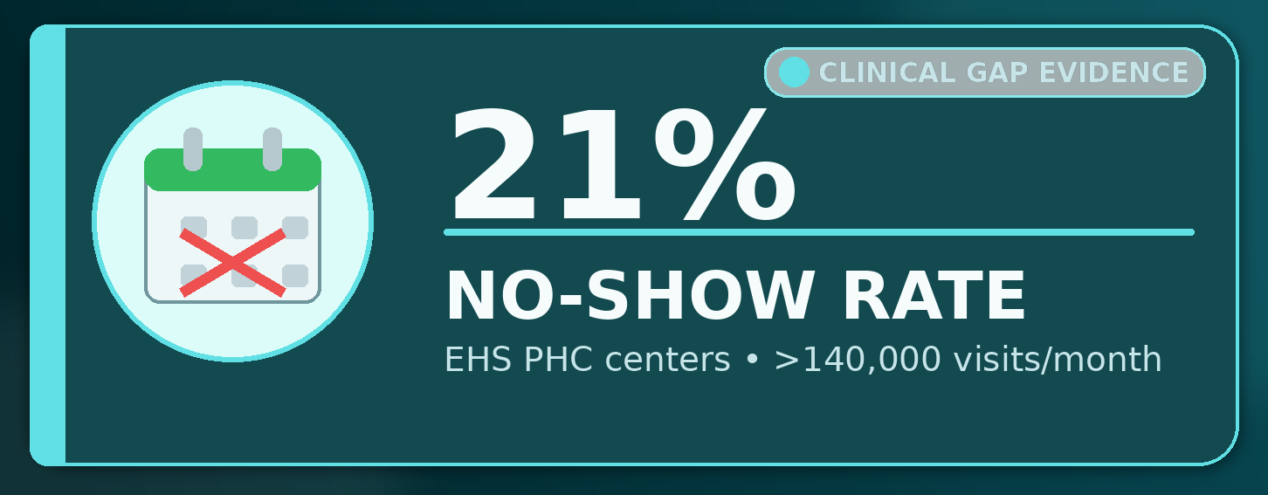


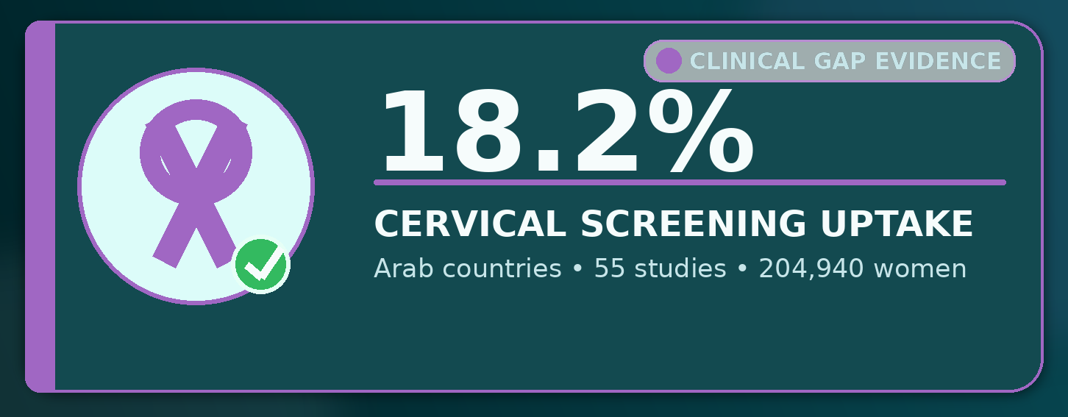
THE CLINICAL PROBLEM
Preventive services exist, but patients often miss appointments or do not complete recommended screening and follow-up. This wastes clinic capacity and delays early detection of disease.
TARGET PATIENT POPULATION
Adults in UAE outpatient and primary-care settings eligible for preventive screening, annual checkups, or chronic disease follow-up, especially adults aged 40+ and senior citizens requiring repeated preventive care.
Consequences
Delayed detection of preventable disease.
Missed chronic disease follow-up.
Wasted appointment slots and clinic resources.
Increased downstream healthcare burden.
Reduced long-term preventive-care adherence.
This challenge is especially relevant for senior citizens and caregivers, populations already recognized in UAE initiatives such as Barakatna.
Notes:
21% no-show rate was reported in Emirates Health Services primary healthcare centers, which manage over 140,000 visits monthly https://formative.jmir.org/2025/1/e64936 , which can lead to an estimated 3%-14% revenue loss
In a UAE study of 2,100 residents aged ≥40, colorectal cancer screening uptake was only 9.1%

Slide 4
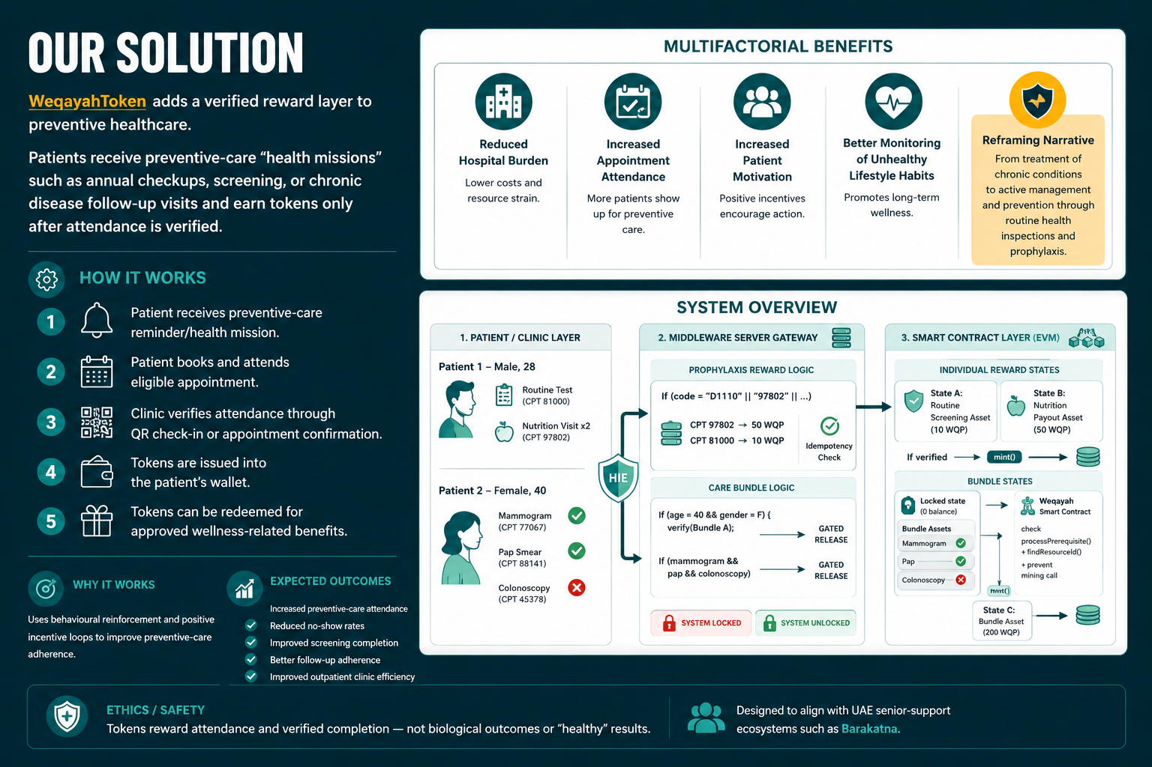
Ai generated image

Slide 5
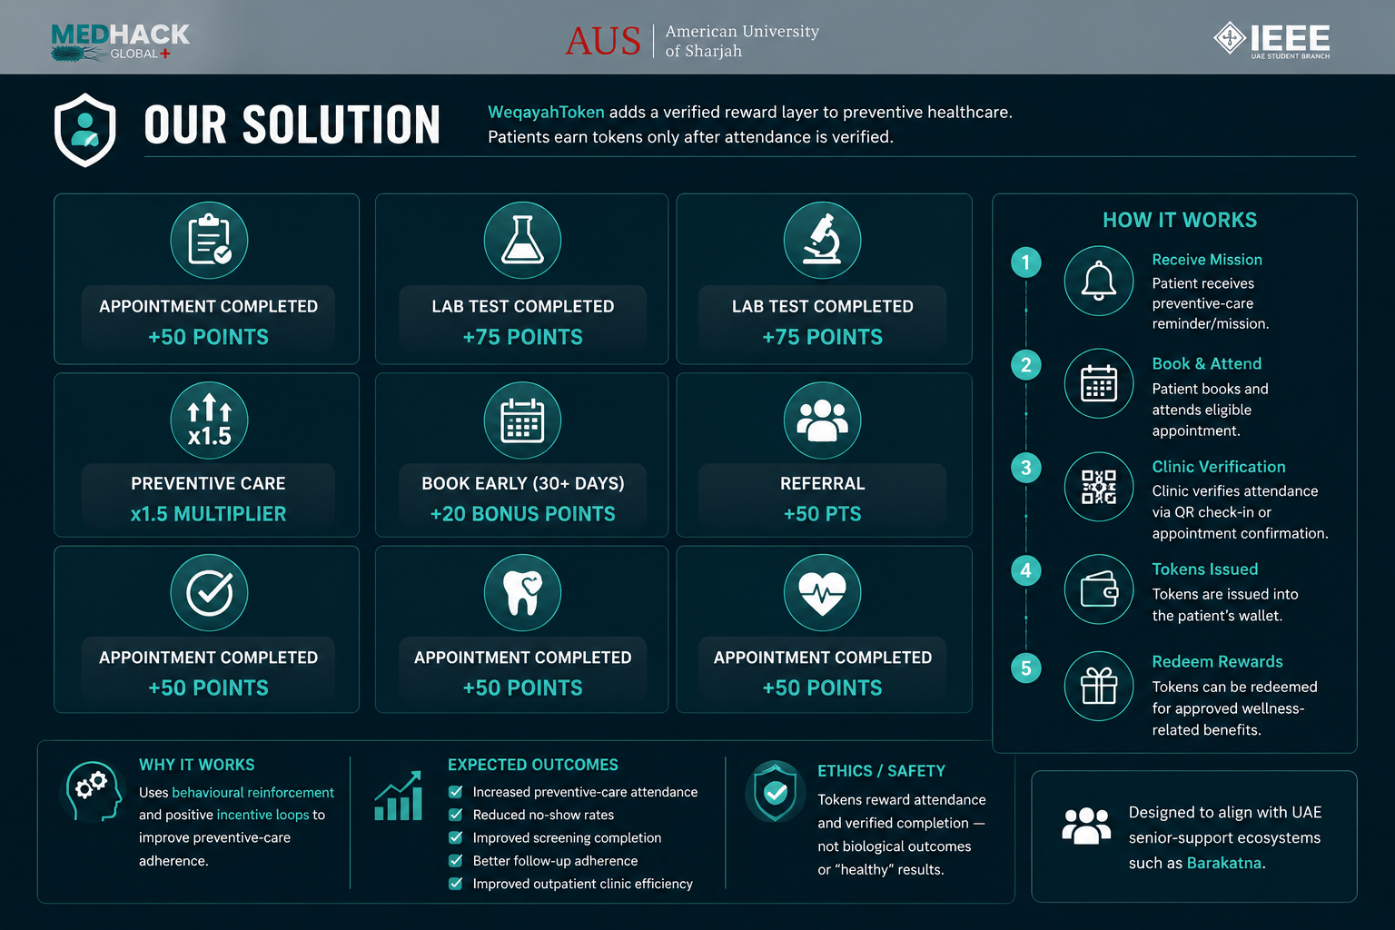
Ai generated image

Slide 6
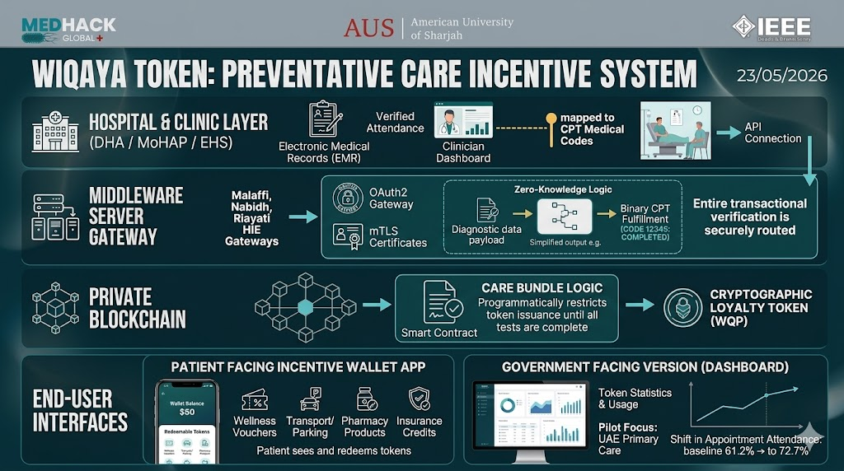
System Flow Map of Key Operational Processes
Ai generated image

Slide 7
Secure 4-Step Data Flow
23/05/2026
1. Clinical Trigger: The patient attends a checkup, and the hospital's EMR automatically maps the visit to a standardized CPT medical code.
2. Secure Gateway: The record is routed via regional health exchanges (Malaffi, Nabidh, Riayati). Zero-knowledge logic verifies the completion status (Yes/No) without exposing any private diagnostic data.
3. Smart Contract: A private blockchain runs "Care Bundle Logic" to ensure all demographic test requirements are met before minting WQP tokens.
4. Dual Output: Tokens are issued directly to the patient's mobile incentive wallet for redemption, while anonymous statistics feed into a government-facing dashboard.
Strategic Impact
Why it Works: It directly combats the UAE's high 37% clinic no-show rate by shifting patients from reactive treatment to proactive prevention using immediate, tangible rewards.
Why it's Practical: It requires no new infrastructure from hospitals, integrating invisibly via APIs into existing EMR systems (like Epic). Financially, funding upfront preventative tokens costs a fraction of treating advanced, neglected chronic diseases.

Slide 8
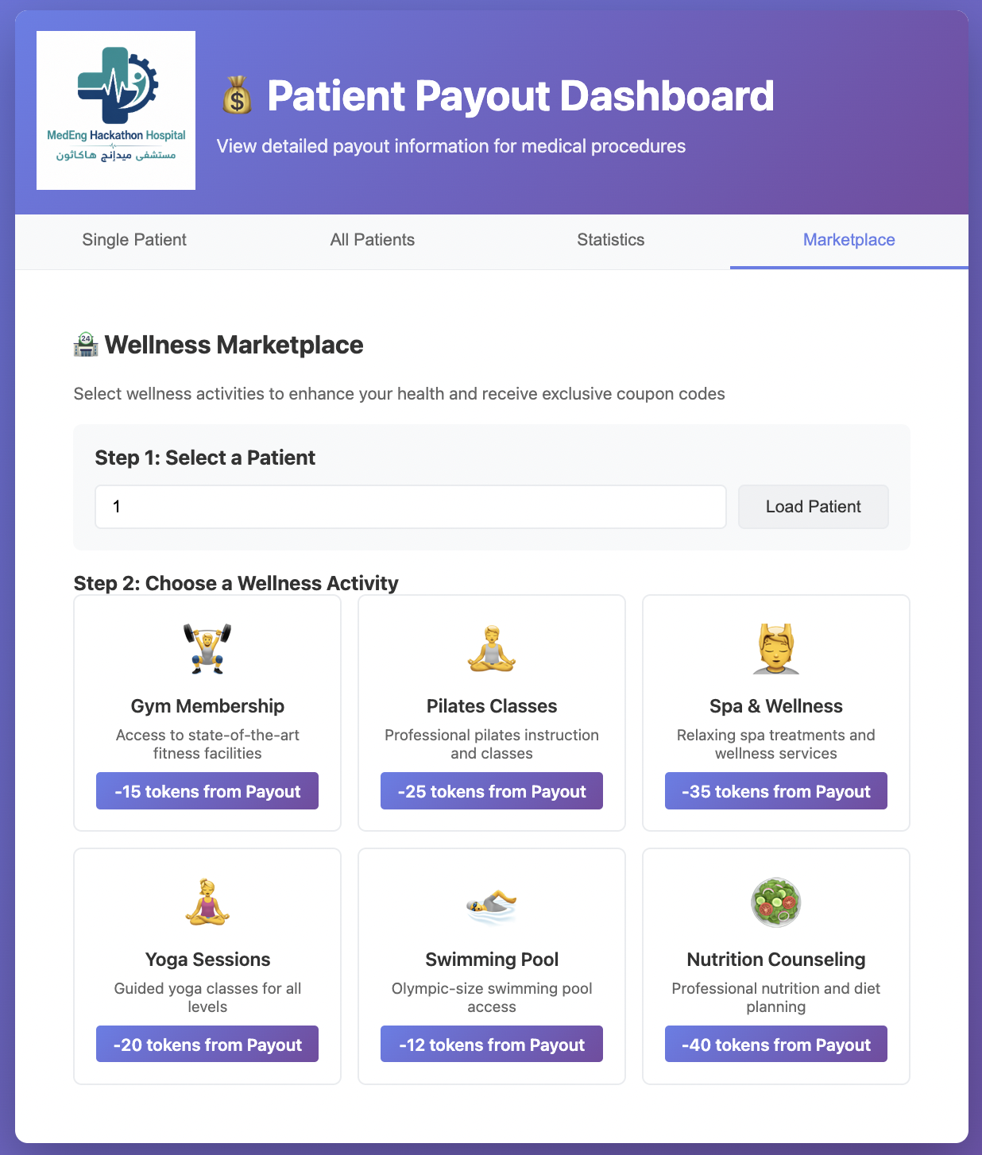
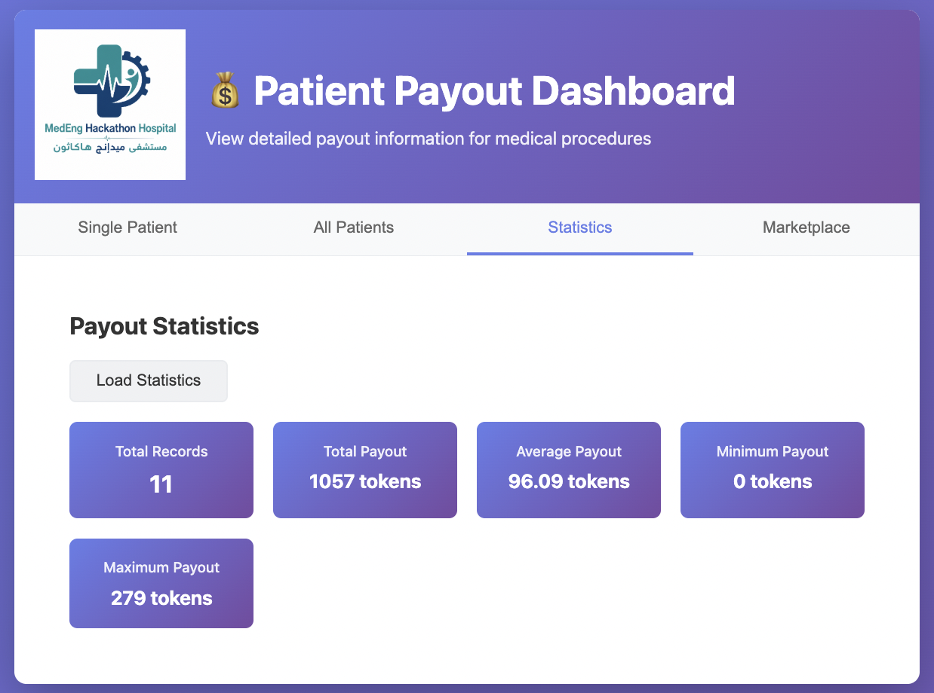
OUR PROTOTYPE
Hospital clinic layer (DHA/MoHAP/EHS) communicates with the middleware server gateway via API which then outputs a smart contract layer which on the government facing version showcases token statistics and the patient facing app allows patient to see and redeem available tokens

Slide 9
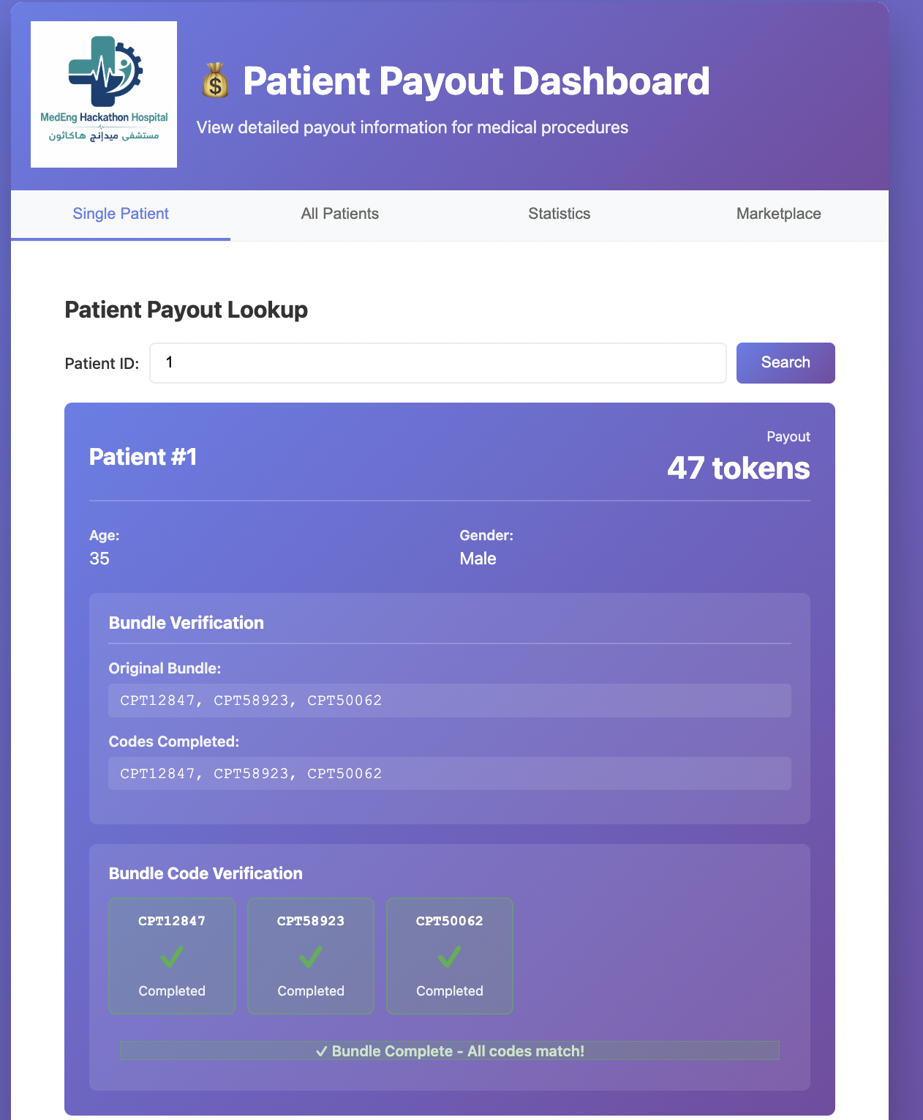
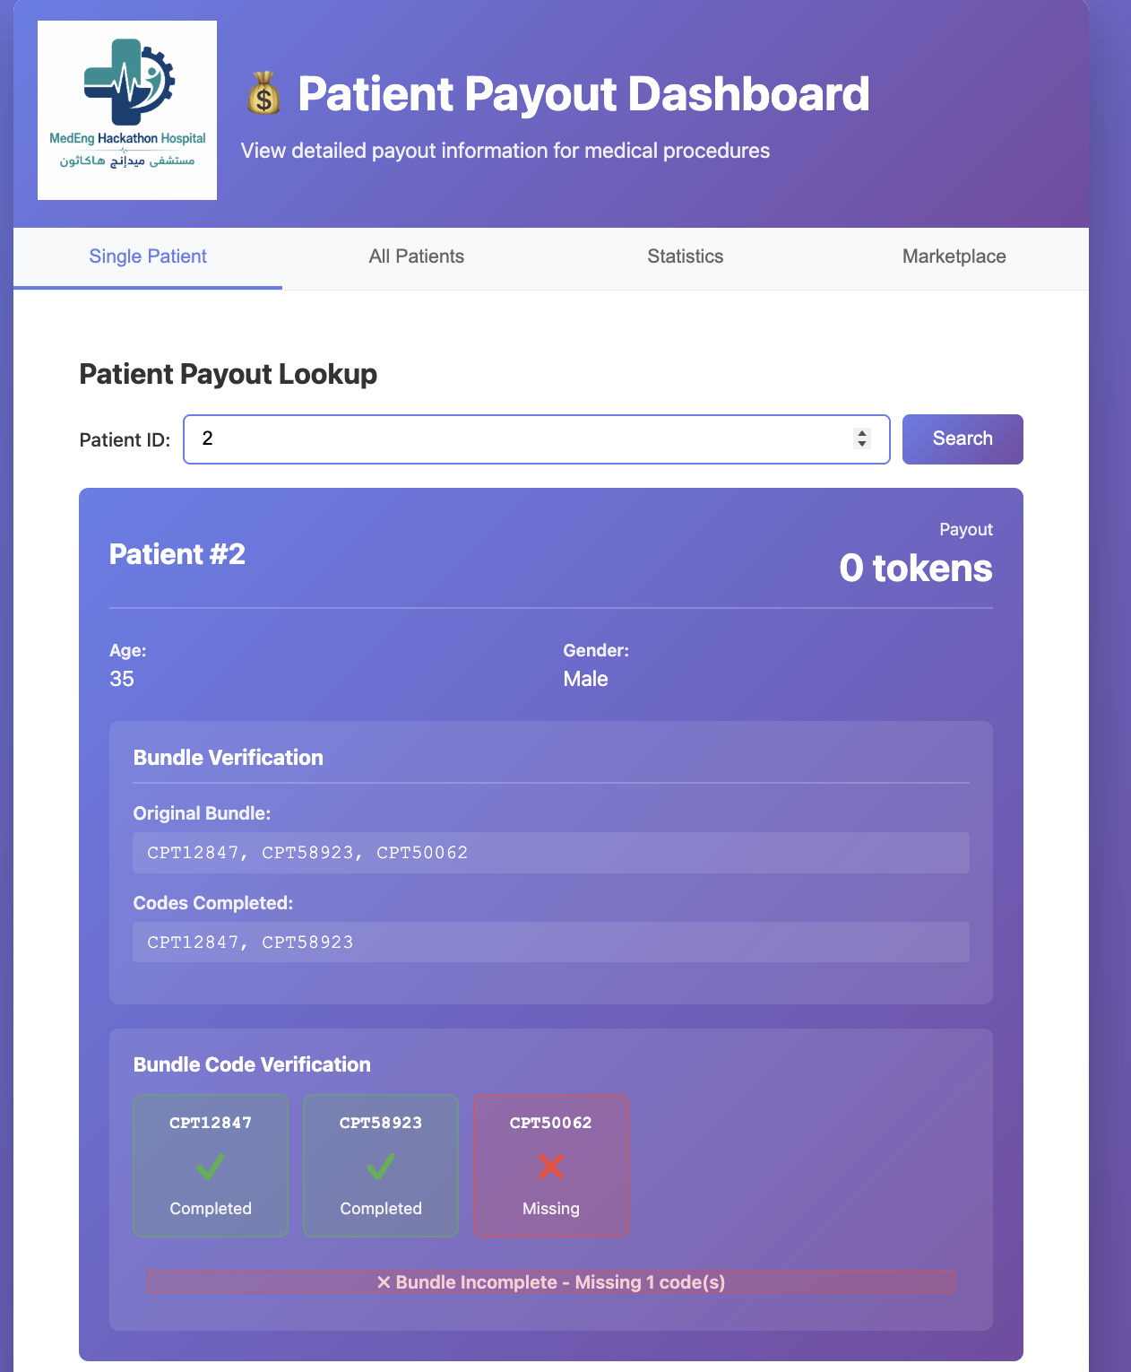
http://localhost:8000
http://localhost:8000
OUR PROTOTYPE
Test bundle codes issued by physician show up as validated as completed or not -if one part of the bundle is not completed tokens are not issued
We plan to stop over-issuing of tokens by limiting for example number of physicals/year or blood work done if no doctors note is provided as evidence for token to be issued

Slide 10
BUSINESS MODEL
Strategic Focus
Target Buyer: The Government
Deployment Setting: Patient-facing app in UAE
The Resource & Materials Budget:
Core Requirement Category
Estimated Cost (USD)
Estimated Cost (AED)
1. Digital & Software Assets
Cloud server space, private blockchain nodes, secure API keys, middleware setup
$24,500
AED 90,000
2. Physical & Hardware Materials
Sensors, microcontrollers, casing
$0
AED 0
3. Operational & Licensing Costs
Hospital deployment via HIE gateways, security audit, compliance check
$43,500
AED 160,000
Total Pilot Estimate
$68,000
AED 250,000

Slide 11
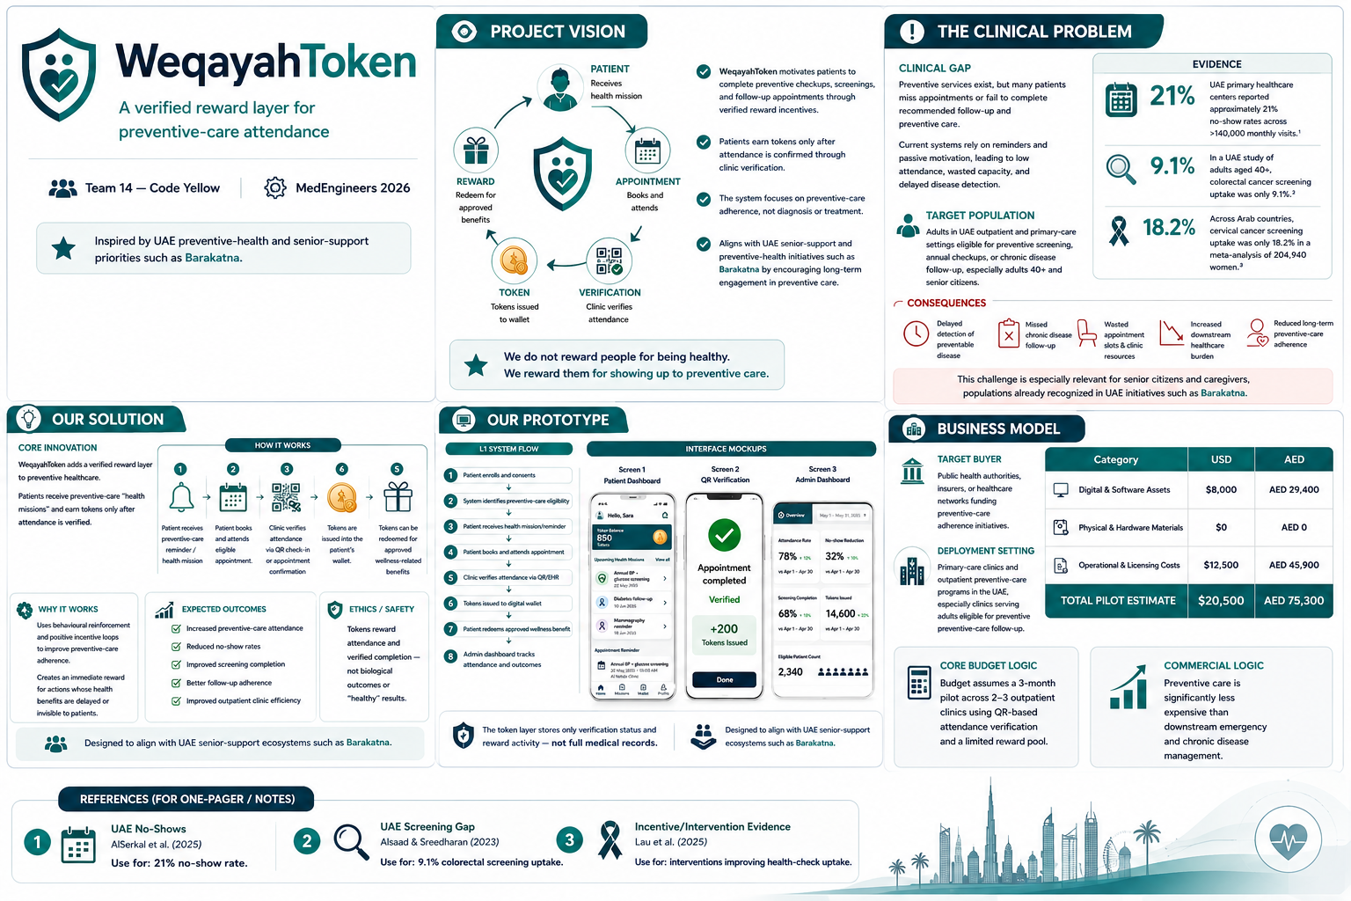
Ai generated image

Slide 12
THANK YOU
Prevention should not depend on memory alone

Slide 13
References
AlSerkal, Y. M., Ibrahim, N. M., Alsereidi, A. S., Ibrahim, M., Kurakula, S., Naqvi, S. A., Khan, Y., & Oottumadathil, N. P. (2025). Real-time analytics and AI for managing no-show appointments in primary health care in the United Arab Emirates: Before-and-after study. *JMIR Formative Research, 9*, e64936. https://doi.org/10.2196/64936
Alsaad, L. N., & Sreedharan, J. (2023). Practice of colorectal cancer screening in the United Arab Emirates and factors associated: A cross-sectional study. *BMC Public Health, 23*, 2015. https://doi.org/10.1186/s12889-023-16951-7
Lau, W. Y., Lian, J., & Yap, M. (2025). The effectiveness of interventions used to improve general health check uptake by the older adult population: A systematic review and meta-analysis. *PLOS Global Public Health, 5*(3), e0004362. https://doi.org/10.1371/journal.pgph.0004362
Ahmed, H. A. A., Abbas, M. H., Hussein, H. A., Nasr, R. S. F., Lashen, A. A., Khaled, H., & Azzam, A. (2024). Cervical cancer screening uptake in Arab countries: A systematic review with meta-analysis. *BMC Cancer, 24*, 1438. https://doi.org/10.1186/s12885-024-13204-7
Hajat, C., & Harrison, O. (2012). Weqaya: A population-wide cardiovascular screening program in Abu Dhabi, United Arab Emirates. *American Journal of Public Health, 102*(5), 909–914. https://doi.org/10.2105/AJPH.2011.300290
Youssef, A. (2014). Use of short message service reminders to improve attendance at an internal medicine outpatient clinic in Saudi Arabia: A randomized controlled trial. *Eastern Mediterranean Health Journal, 20*(5), 317–323.
Aziz, A., AlShammari, M., Alasmari, S., Alotaibi, N., Alhamdan, H., Alhammad, N., Alwhaibi, M., Alshammari, T., & Aljadhey, H. (2020). Use of Google Trends to monitor COVID-19 public interest and behavior in the Gulf Cooperation Council countries: Exploratory infodemiology study. *JMIR Public Health and Surveillance, 6*(2), e18818. https://doi.org/10.2196/18818

